Slide 1
Conclusion, and Final Exam Review
Notes:
set-up :
https://scheme.cs61a.org/ demo: (define (falsey val) (begin (print val) #f))
(define-macro (if-macro cond1 expr1 else expr2) `(if ,cond1 ,expr1 ,expr2))
___
(define-macro (add-or-sub cond1 x1 x2)`(if ,cond1 (+ ,x1 ,x2)(- ,x1 ,x2)))

Slide 2
What Is this course about?
A course about managing complexity
Mastering functional abstraction and data abstraction
Learning trade-offs of various programming paradigms
An introduction to programming
Learning how to write programs in Python, Scheme, and SQL
Combining multiple programming techniques in large projects
Understanding how computers interpret programming languages
A challenging course that demanded a lot of you

Slide 3
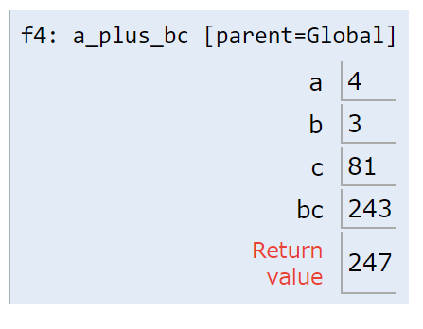
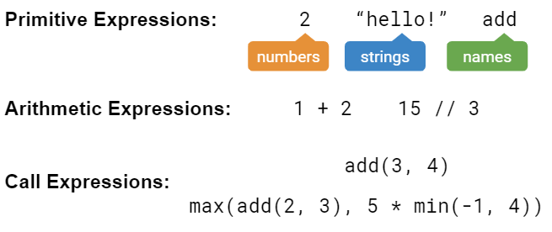
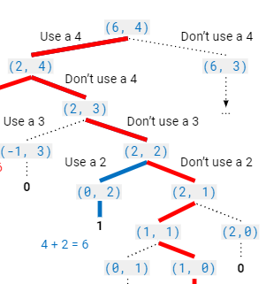
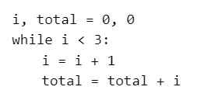
“Building Blocks” of Programs

Slide 4
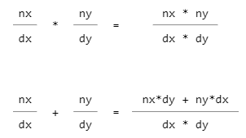

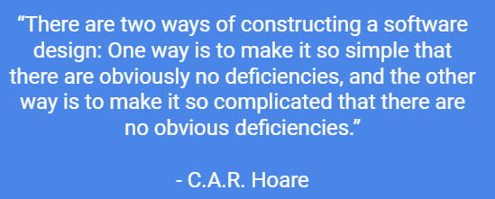
Managing Complexity

Slide 5
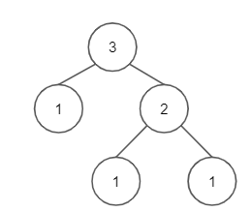
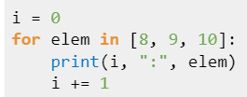
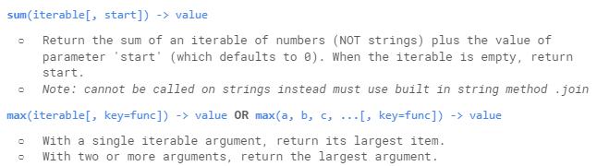
Representing Collections of Data

Slide 6
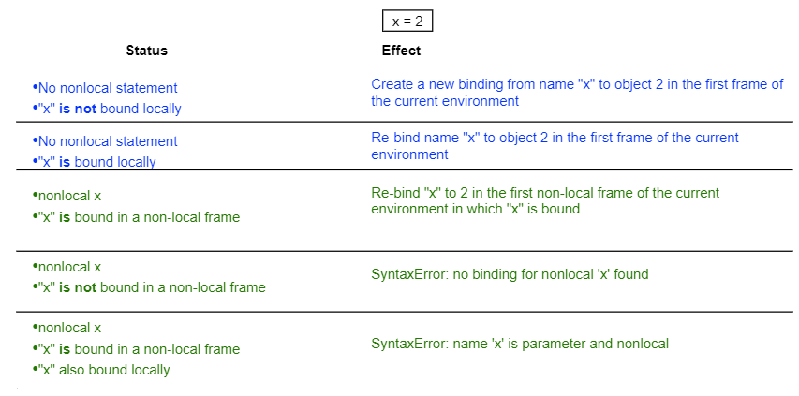

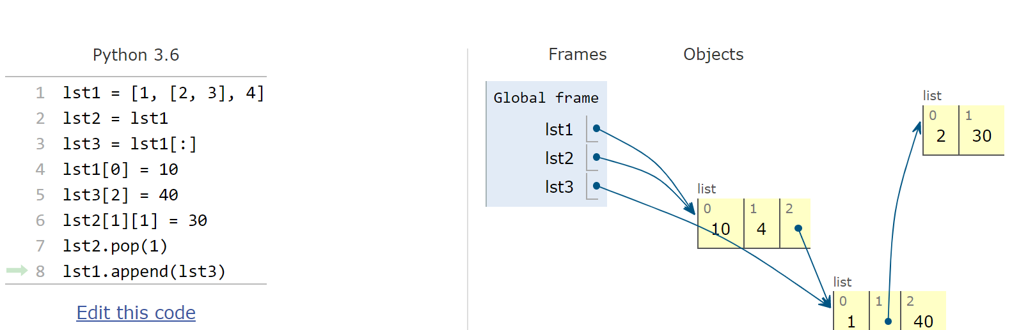
Mutability

Slide 7
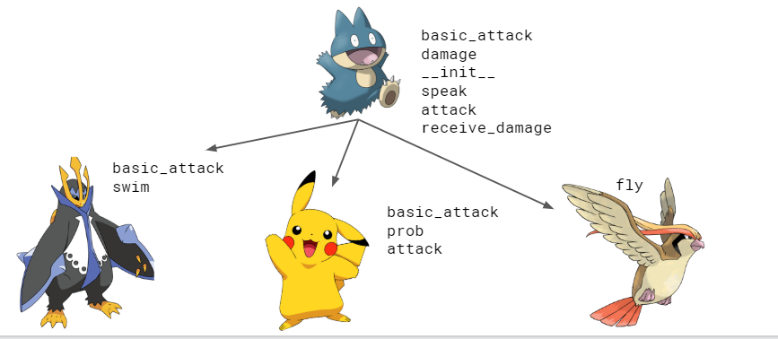

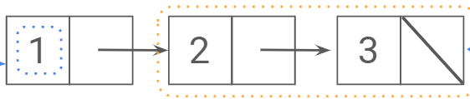
Object-Oriented Programming

Slide 8


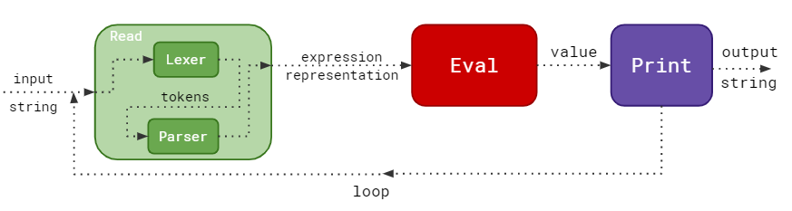
Languages

Slide 9
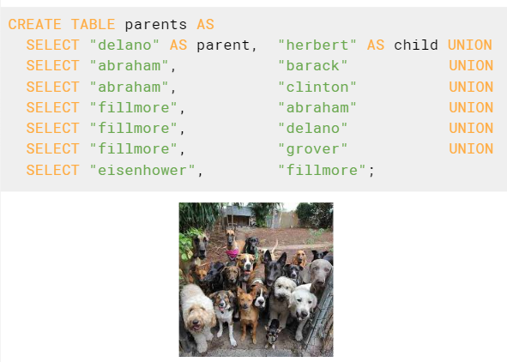
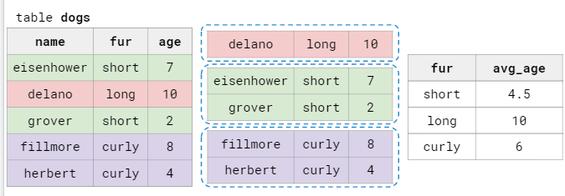
Paradigms & Databases

Slide 10
Final Exam Review: Agenda
Macros
Trees
SQL
(There are review slides relating to other topics on the skipped slides - feel free to view those at home!)

Slide 11
(Higher-Order) Functions

Slide 12
Functions
A function is made up of a series of statements, and takes in an input and maps it to an output.
How we describe functions:
Domain: The set of possible inputs a function may take in.
Range: The set of possible output values a function may return.
Behavior: The relationship between input and output.
EXAM TIP:
Pay close attention to the specified domain and range of a function on the exam. What do the parameters represent? What should the function return?

Slide 13
Higher Order Functions
A higher-order function is:
A function that takes a function as an argument and/or
A function that returns a function as a return value
¹
²
³
def do_twice(f):
f()
f()
¹
²
³
def do_nothin(f):
return f
and/or

Slide 14
Lambda Expressions
A lambda expression is an expression that evaluates to a function.
In the above example, on line 1, the RHS is a lambda expression that evaluates to a function; and then we are binding it to f.
Note:
Lambda functions have no intrinsic name
Their parent frame is the frame in which they were defined
>>> f = lambda x: x * x
>>> f(2)
4
do_twice(lambda: print(“Hello!”))
http://bit.ly/lambda4eva

Slide 15
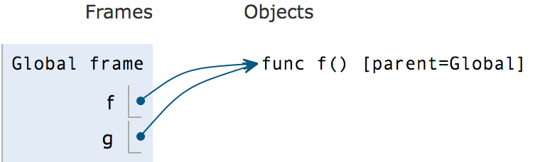
Functions in Environment Diagrams
def f():
return 1
g = f
Unlike primitive values, functions are written in the objects section.
We also write the parent of the function, the frame in which it was defined.
When a function is passed to another variable, we draw another arrow to the existing function object.

Slide 16
Environment Diagram Tips
Name of frame should be intrinsic name of function
Parent frame of a function never changes once you write it down
Don't conflate: function name vs. function call
Remember evaluation procedure
Evaluate the operator (usually a lookup)
Evaluate the operands (may involve calling another function)
Apply the operator on the operands (this is where you actually call the function and make a new frame)

Slide 17
Practice: Hippity-Hoppity-HOFy
Please draw an environment diagram for the following program.
def hop(y):
def hip(f):
return wrap(f(y))
def wrap(x):
return x + y
return hip
z = hop(2)(lambda x: x+2)
links.cs61a.org/mtreview-hiphop
Notes:
Remind the students why the parent of the lambda function is the global frame

Slide 18
Practice: do_n_then_again
Implement a function that takes in a positive integer n, a value x, and returns a function that will continue to take in functions one at a time, applying the first function to x n times, the second function to the new value of x (n-1) times, and so on until n functions have been passed in; after which the value after all of the operations is returned.
>>> do_n = do_n_then_again(1, 2)
>>> do_n(lambda x: x * x)
4 # (2 * 2)
>>> do_n = do_n_then_again(3, 2)
>>> do_n(lambda x: x+2)(lambda x: x*x)(lambda x: -x)
-4096 # (((2 + 2 + 2 + 2)^2)^2) * -1

Slide 19
Implement do_n_then_again
>>> do_n = do_n_then_again(1, 2)
>>> do_n(lambda x: x * x)
4 # (2 * 2)
>>> do_n = do_n_then_again(3, 2)
>>> do_n(lambda x: x+2)(lambda x: x*x)(lambda x: -x)
-4096 # (((2 + 2 + 2 + 2)^2)^2) * -1
¹
²
³
⁴
⁵
⁶
⁷
⁸
⁹
def do_n_then_again(n, x):
def do_n(f):
if __________:
return __________
_________
for _ in __________:
__________________
return do_n_then_again(____, ___)
return do_n
def do_n_then_again(n, x):
def do_n(f):
if n == 1:
return f(x)
new_x = x
for _ in range(n):
new_x = f(new_x)
return do_n_then_again(n-1, new_x)
return do_n
Notes:
Play animations on this slide to see the skeleton code

Slide 20
Sequences

Slide 21
The Basics
Definitions:
Sequence: a collection of values
List: an ordered sequence of values of any data type
Index: start from 0
Functions:
len(lst): returns number of elements in the list
range(start, end): function creates a sequence containing the values within a specified range.
start is inclusive, end is exclusive
can work with 1 input; start defaults to 0
Ie. range(0,5) is the same as range(5)

Slide 22
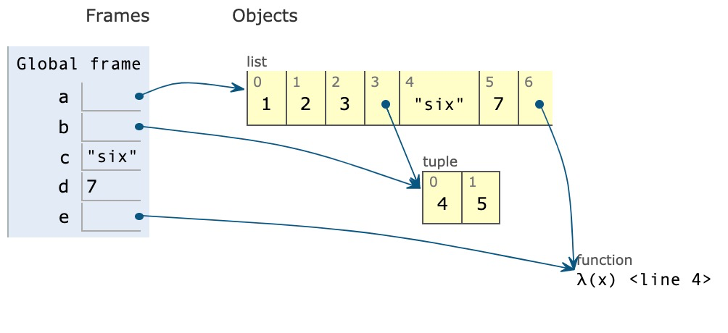
Box and Pointer Diagram
Lists are drawn using boxes and pointers in environment diagrams
1 a = [1, 2, 3]
2 b = [4,5]
3 c , d = “six” , 7
4 e = lambda x: 8
5 a.append(b)
6 a.append(c)
7 a.append(d)
8 a.append(e)
Python Tutor

Slide 23
For loop & List comprehension
Suppose that we’re given a list and want to make a new one where we double all the even elements of the original.
For loops are a convenient way to iterate through a list
1 result = []
2 for elem in a_list:
3 if elem % 2 == 0:
4 result += [elem * 2]
5 return result
List Comprehensions are a compact way to create a new list from an existing one
1 result = [elem*2 for elem in a_list if elem % 2 == 0]

Slide 24
Mutating a list vs. Creating a list
lst.append(element)
lst.extend(sequence)
lst1 += lst2
lst.insert(index, element)
lst.remove(element)
lst.pop(index)
lst1[0:1] = lst2[0:5]
replaces the 0-th box with 5 elements from lst2
All of above except pop return None
Slicing
lst[start:end:step]
Shallow copying
lst[:]
Concatenating
lst1 = lst1 + lst2
List constructor
lst2 = list(lst1)
Notes:
Alex: put em on yer cheat sheet

Slide 25
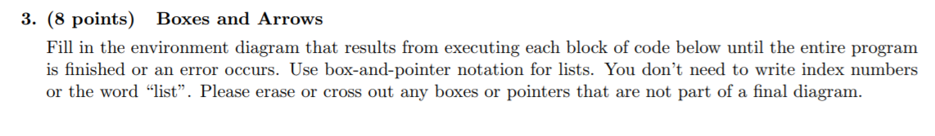
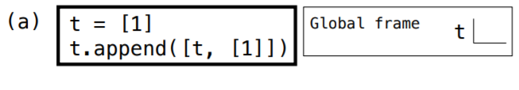
Question 3: (Fall 2016)

Slide 26
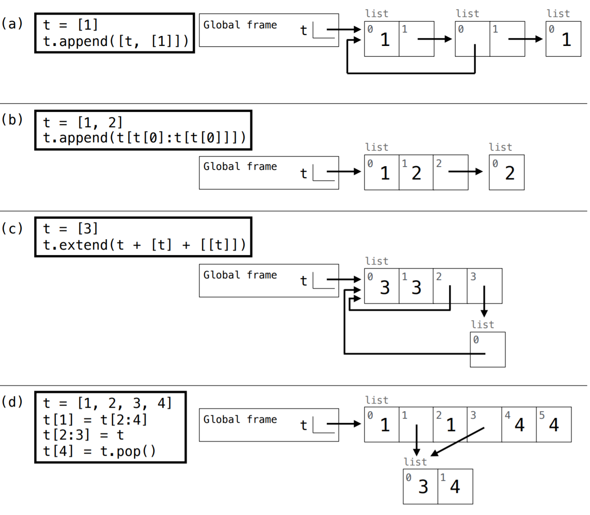
Question 3: (Fall 2016)

Slide 27
Question 3: (Fall 2016)

Slide 28
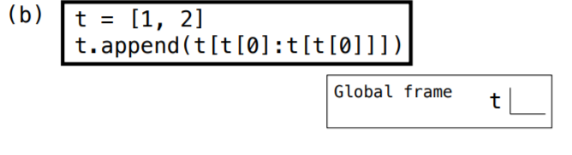
Question 3: (Fall 2016)

Slide 29
Question 3: (Fall 2016)

Slide 30
Question 3: (Fall 2016)
eval operand:
t.append( t [ 1 : t [1] ])
t.append( t [ 1 : 2 ])
t.append( [2] )

Slide 31
Question 3: (Fall 2016)
eval operand:
t.append( t [ 1 : t [1] ])
t.append( t [ 1 : 2 ])
t.append( [2] )

Slide 32
Summer 14 Midterm 2 (Modified)
Draw box and pointer Diagram for the following code.
1 a = [1, 2, 3]
2 b = [4, a, lambda: a[2][0]]
3 a[0] = b[1] is a
4 a[2] = b
5 c = b[:]
6 a[1] = c[2]()
7 d = b[1].pop(0)
8 b[1].append(d)
Python Tutor

Slide 33
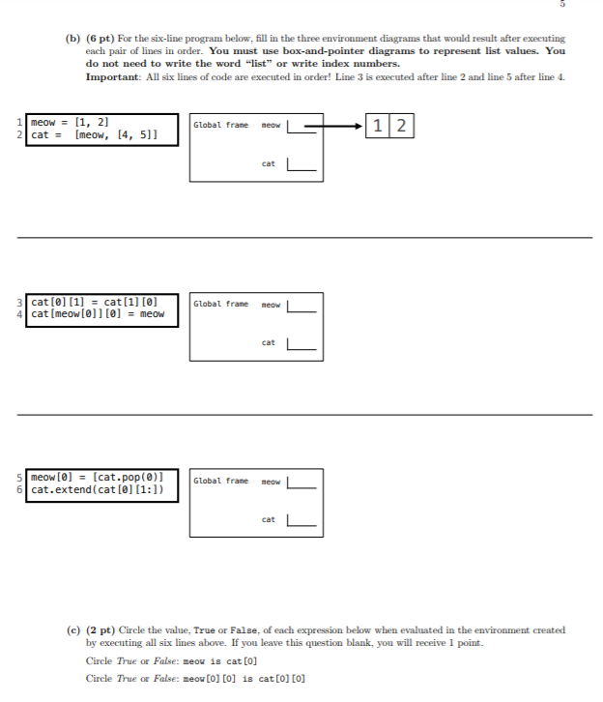
Fall 14 Final

Slide 34
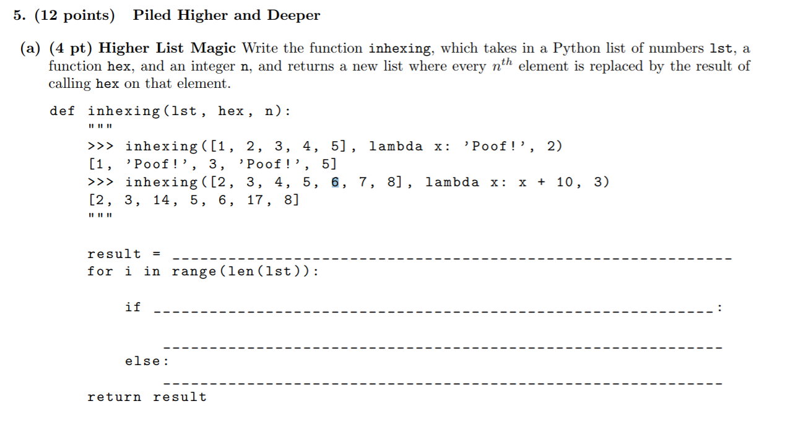
Su14 Midterm 2
1 def inhexing(lst, hex, n):
2 result = _______________
3 for i in range(len(lst
4 elif n < 0:
5 return 0
6 elif m == 0:
7 return 0
8 else:
9 wit_m = count_part(n - m, m)
10 wo_m = count_part(n, m - 1)
11 return with_m + wo_m

Slide 35
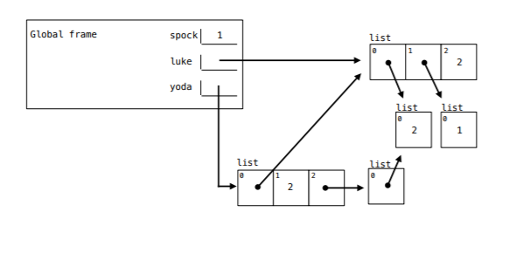
Fall 14 Midterm 2
Fill in the blanks that the code results in the environment diagram shown. You can use only brackets, commas, colors and te names luke, spock, and yoda, NOT integer literals
1 spoke, yoda = 1, 2
2 luke = [ ]
3 yoda = 0
4 yoda = [ ]
5 yoda.append( )

Slide 36
Recursion and Tree Recursion

Slide 37
The Basics
Base Case(s)
Simplest possible inputs for the problem
May be more than one!
Shrinking the problem
Call the function again with slightly smaller inputs!
Using the solved smaller problem
To write a working recursive function, you should assume that you can call it on smaller input and use this to solve the larger problem

Slide 38
Tree Recursion
Recursive function with (potentially) more than one recursive call
Rest is the same!
When you draw out the function calls, it forms a tree shape
Usually split up into different cases: you take one of several options or explore all the different choices
Example: Count Partitions (yes, again)

Slide 39
Revisiting Count Partitions
Suppose we want to find all the sets of integers which sum to 4, where all the integers are positive and less than or equal to 3.
1 def count_part(n, m):
2 if n == 0:
3 return 1
4 elif n < 0:
5 return 0
6 elif m == 0:
7 return 0
8 else:
9 with_m = count_part(n - m, m)
10 wo_m = count_part(n, m - 1)
11 return with_m + wo_m
Two possibilities:
Set has a 3
It doesn’t
Generally, many tree recursion problems have cases of the form “use this first one or don’t”, or “use one of these”
Why do we consider these two cases?
They don’t overlap, include all the possible solutions, and slowly work towards our base cases.

Slide 40
Practice Problem: Your Father’s Parentheses
Suppose we have a sequence of quantities that we want to multiply together, but can only multiply two at a time.
We can express the various ways of doing so by counting the number of different ways to parenthesize the sequence.
Define a function count_groupings(n) that returns the number of ways parenthesizing the product of n numbers, where n > 0.
Source: Mt1, Spring 2016

Slide 41
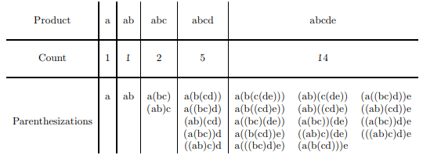
Your Father’s Parentheses
For example, here are the possibilities for products of 1, 2, 3, 4 and 5 elements:
Notes:
d

Slide 42
Your Father’s Parentheses
def count_groupings(n):
if n == 1:
return ____________________________________
elif n == 2:
return ____________________________________
_______________________________________________
for ___________________________________________
__________________________________________
return ________________________________________

Slide 43
Your Father’s Parentheses
def count_groupings(n):
if n == 1:
return 0___________________________________
elif n == 2:
return 1___________________________________
_______________________________________________
for ___________________________________________
___________________________________________
return ________________________________________

Slide 44
Your Father’s Parentheses
def count_groupings(n):
if n == 1:
return 0___________________________________
elif n == 2:
return 1___________________________________
total = 0______________________________________
for i in range(1, n)___________________________
total += count_groupings(i) * count_groupings(n - i)
return total___________________________________

Slide 45
Your Father’s Parentheses
def count_groupings(n):
if n == 1:
return 1___________________________________
elif n == 2:
return 1___________________________________
total = 0______________________________________
for i in range(1, n)______________________
total += count_groupings(i) * count_groupings(n - i)
return total___________________________________

Slide 46
Trees

Slide 47
The Tree Data Abstraction
Constructor def tree(label, branches=[]): Pass in a value (label) for the root node, and a list of branches. Each branch must itself also be a tree. Selectors def label(tree): Returns a value: whatever is stored in the root node.
def branches(tree): Returns a list of tree’s subtrees.
def is_leaf(tree): Returns a boolean: true if tree has no children, false otherwise.

Slide 48
General Structure for Tree Problems
Base Case: smallest version of the problem - no additional work needed to get answer. (usually if it’s a leaf)
Recursive call: do the same function on smaller parts of the tree (usually on the branches)
Final answer: put together results from all the branches
Aggregator functions (max, min, sum, any, all)
Creating a new tree w/ updated label and branches

Slide 49
Practice Problem: replace_with_sum
Write a function replace_with_sum that takes in a tree, and returns a new tree where each node is the sum of itself and all descendant nodes (its children, its children’s children, ...)
1
36
3
6
10
25
2
7
12
7
7
12
5
5

Slide 50
Practice Problem: replace_with_sum
Write a function replace_with_sum that takes in a tree, and returns a new tree where each node is the sum of itself and all descendant nodes (its children, its children’s children, ...)
1 def replace_with_sum(t):
2 if ___________:
3 return __________________
4 new_branches = _____________
5 branch_sum = sum(___________)
6 return tree(______, _______)
7
8
2
1
4
2
9
3
4
2

Slide 51
Strategy: replace_with_sum
Key idea: take the recursive leap of faith and trust that replace_with_sum will do what it’s supposed to on smaller problems (branches)
1
3
6
2
7
12
5

Slide 52
Strategy: replace_with_sum
Key idea: take the recursive leap of faith and trust that replace_with_sum will do what it’s supposed to on smaller problems (branches)
1
replace_with_sum(b)
replace_with_sum(b)
10
25
7
7
12
5

Slide 53
Strategy: replace_with_sum
Since the branches are all done thanks to recursion, the root node of each branch has the total sum of all nodes in it
1
Sum of green branch: 10
Sum of purple branch: 25
10
25
7
7
12
5

Slide 54
Strategy: replace_with_sum
Add these up with the root node and we’re done!
Note that the only thing left to change after the recursive calls was the root node.
36
10
25
7
7
12
5

Slide 55
Solution: replace_with_sum
Base Case: smallest version of the problem - no additional work needed. (usually if it’s a leaf)
1 def replace_with_sum(t):
2
3
4
5
6
7
8

Slide 56
Solution: replace_with_sum
Base Case: smallest version of the problem - no additional work needed. (usually if it’s a leaf)
1 def replace_with_sum(t):
2 if _____________:
3 return _____________________
4
5
6
7
8

Slide 57
Solution: replace_with_sum
Base Case: smallest version of the problem - no additional work needed. (usually if it’s a leaf)
1 def replace_with_sum(t):
2 if is_leaf(t):
3 return tree(label(t))
4
5
6
7
8
Simplest possible input: if the tree is just a single leaf,
there’s no summing necessary

Slide 58
Solution: replace_with_sum
Recursive call: do the same function on smaller parts of the tree (usually the branches)
1 def replace_with_sum(tree):
2 if is_leaf(tree):
3 return label(tree)
4 new_branches = [replace_with_sum(b) for b in
5 branches(tree)]
6
7
8
1 def replace_with_sum(t):
2 if is_leaf(t):
3 return tree(label(t))
4 new_branches = ______________________________
5
6
7
8

Slide 59
Solution: replace_with_sum
Recursive call: do the same function on smaller parts of the tree (usually the branches)
1 def replace_with_sum(tree):
2 if is_leaf(tree):
3 return label(tree)
4 new_branches = [replace_with_sum(b) for b in
5 branches(tree)]
6
7
8
1 def replace_with_sum(t):
2 if is_leaf(t):
3 return tree(label(t))
4 new_branches = [replace_with_sum(b) for b in
5 branches(t)]
6
7
8
Key: don’t go any deeper down the tree, or think about how the recursive calls work. Just trust that they do what they’re supposed to!

Slide 60
Solution: replace_with_sum
Final answer: put together results from all the branches
1 def replace_with_sum(tree):
2 if is_leaf(tree):
3 return label(tree)
4 new_branches = [replace_with_sum(b) for b in
5 branches(tree)]
6 return tree(sum(new_branches), new_branches)
7
8
1 def replace_with_sum(t):
2 if is_leaf(t):
3 return tree(label(t))
4 new_branches = [replace_with_sum(b) for b in
5 branches(t)]
6 branch_sum = ________________________________
7
8

Slide 61
Solution: replace_with_sum
Final answer: put together results from all the branches
1 def replace_with_sum(tree):
2 if is_leaf(tree):
3 return label(tree)
4 new_branches = [replace_with_sum(b) for b in
5 branches(tree)]
6 return tree(sum(new_branches), new_branches)
7
8
1 def replace_with_sum(t):
2 if is_leaf(t):
3 return tree(label(t))
4 new_branches = [replace_with_sum(b) for b in
5 branches(t)]
6 branch_sum = sum([label(b) for b in new_branches])
7
8

Slide 62
Solution: replace_with_sum
Final answer: put together results from all the branches
1 def replace_with_sum(tree):
2 if is_leaf(tree):
3 return label(tree)
4 new_branches = [replace_with_sum(b) for b in
5 branches(tree)]
6 return tree(sum(new_branches), new_branches)
7
8
1 def replace_with_sum(t):
2 if is_leaf(t):
3 return tree(label(t))
4 new_branches = [replace_with_sum(b) for b in
5 branches(t)]
6 branch_sum = sum([label(b) for b in new_branches])
7 return _______________________________________
8

Slide 63
Solution: replace_with_sum
Final answer: put together results from all the branches
1 def replace_with_sum(tree):
2 if is_leaf(tree):
3 return label(tree)
4 new_branches = [replace_with_sum(b) for b in
5 branches(tree)]
6 return tree(sum(new_branches), new_branches)
7
8
1 def replace_with_sum(t):
2 if is_leaf(t):
3 return tree(label(t))
4 new_branches = [replace_with_sum(b) for b in
5 branches(t)]
6 branch_sum = sum([label(b) for b in new_branches])
7 return tree(label(t) + branch_sum, new_branches)
8
Note: after the recursive calls, the only thing you need to modify directly is the root label

Slide 64
Solution: replace_with_sum
1 def replace_with_sum(t):
2 if is_leaf(t):
3 return tree(label(t))
4 new_branches = [replace_with_sum(b) for b in
5 branches(t)]
6 branch_sum = sum([label(b) for b in new_branches])
7 return tree(label(t) + branch_sum, new_branches)
8

Slide 65
Practice Problem: closest (Sp15)
Implement closest, which takes a tree of numbers t and returns the smallest absolute difference anywhere in the tree between a label and the sum of the labels of its branches.
1 def closest(t):
2 """
3 # |10 - (2 + 8)| = 0
4 >>> closest(tree(10,
5 [tree(2), tree(8,
6 [tree(4), tree(3)])]))
7 0
8
9 diff = abs(______________________________________)
10 return min(______________________________________)
11

Slide 66
Practice Problem: closest (Sp15)
Smallest difference: 0
(|10 - (2+8)| = 0)
10
Smallest difference: 2
2
8
Smallest difference: 1
(|8- (4 + 3)| = 1)
4
3

Slide 67
Practice Problem: closest (Sp15)
Smallest difference: 0
(|10 - (2+8)| = 0)
10
Smallest difference: 2
2
8
Smallest difference: 1
(|8 - (4 + 3)| = 1)
4
3

Slide 68
Practice Problem: closest (Sp15)
Implement closest, which takes a tree of numbers t and returns the smallest absolute difference anywhere in the tree between a label and the sum of the labels of its branches.
1 def closest(t):
2 """
3 # |10 - (2 + 8)| = 0
4 >>> closest(tree(10,
5 [tree(2), tree(8,
6 [tree(4), tree(3)])]))
7 0
8
9 diff = abs(______________________________________)
10 return min(______________________________________)
11

Slide 69
Strategy: closest (Sp15)
Start by looking at the skeleton for hints.
No if...probably an implicit base case! (list comprehension?)
min...will probably consider many possible closest values
1 def closest(t):
2 """
3 # |10 - (2 + 8)| = 0
4 >>> closest(tree(10,
5 [tree(2), tree(8,
6 [tree(4), tree(3)])]))
7 0
8
9 diff = abs(______________________________________)
10 return min(______________________________________)
11

Slide 70
Strategy: closest (Sp15)
Key idea: we can check the smallest difference using each of the branches, and the smallest difference using the root node, then pick the smallest of all of them
Smallest difference: 0
(|10 - (2+8)| = 0)
10
Smallest difference: 2
2
8
Smallest difference: 1
(|8- (4 + 3)| = 1)
4
3

Slide 71
Strategy: closest (Sp15)
Key idea: we can check the smallest difference using each of the branches, and the smallest difference using the root node, then pick the smallest of all of them
Smallest difference: 0
(|10 - (2+8)| = 0)
10
Smallest difference: 2
2
8
Smallest difference: 1
(|8 - (4 + 3)| = 1)
4
3

Slide 72
Solution: closest (Sp15)
Start by finding the smallest difference using the root node.
1 def closest(t):
2 """
3 # |10 - (2 + 8)| = 0
4 >>> closest(tree(10,
5 [tree(2), tree(8,
6 [tree(4), tree(3)])]))
7 0
8
9
10
11

Slide 73
Solution: closest (Sp15)
Start by finding the smallest difference using the root node.
1 def closest(t):
2 """
3 # |10 - (2 + 8)| = 0
4 >>> closest(tree(10,
5 [tree(2), tree(8,
6 [tree(4), tree(3)])]))
7 0
8
9 diff = abs(label(t) - sum([label(b) for b in
10 branches(t)]))
11

Slide 74
Solution: closest (Sp15)
Then find the smallest difference for each of the branches.
Pick the smallest overall result (using min) for the final answer.
1 def closest(t):
2 """
3 # |10 - (2 + 8)| = 0
4 >>> closest(tree(10,
5 [tree(2), tree(8,
6 [tree(4), tree(3)])]))
7 0
8
9 diff = abs(label(t) - sum([label(b) for b in
10 branches(t)]))
11 return min([diff] + [closest(b) for b in branches(t)])

Slide 75
Solution: closest (Sp15)
1 def closest(t):
2 """
3 # |10 - (2 + 8)| = 0
4 >>> closest(tree(10,
5 [tree(2), tree(8,
6 [tree(4), tree(3)])]))
7 0
8
9 diff = abs(label(t) - sum([label(b) for b in
10 branches(t)]))
11 return min([diff] + [closest(b) for b in branches(t)])

Slide 76

Macros

Slide 77
Quoting & Quasi-quoting
'Quoting: prevents executing a following expression
`Quasiquoting: allows for user to specify if any sub-expression within the list should be unquoted, and hence, looked up.
an example ...
scm> '(+ 1 2) ;same as (quote (+ 1 2))
(+ 1 2)
scm> (+ 1 2)
3
scm> (define x 2)
x
scm> `(1 x 3)
(1 x 3)
scm> `(1 ,x 3)
(1 2 3)
(1 2 3)
OR
(1 x 3)
????
????
Notes:
https://scheme.cs61a.org/

Slide 78
How to evaluate macros?
(can use to test your code)
Evaluate operator
Apply operator to unevaluated operands
perform lookups & return macro body
Hard Evaluate the expression returned by the macro in the frame it was called in.
scm> (define-macro (twice f)
`(begin ,f ,f))
twice
scm> (twice (print 2))
2
2
this is what gets returned!
`(begin (print 2)(print 2))
(eval `(begin (print 2)(print 2)))
any questions so far?
Notes:
https://scheme.cs61a.org/

Slide 79
but how do we write a macro?
write out the expression as you would normally do so if it were inside define.
Put the necessary quotes/lists …
do not quote things that you want to look up in that frame
Do a hard eval(...) on expressions you might want to evaluate right there!
quote things that you don’t want to look up/evaluate initially
Notes:
https://scheme.cs61a.org/

Slide 80
Construct a Macro that works like an if!
(define-macro (if-macro cond1 expr1 else expr2)
)
;;scm>(if-macro (print 3) (print 'ryan) else (print 'cesar))
;;3
;;ryan
None is a truthy value in scheme!
Tips!
Write out the expression as you would normally do so if it were inside define.
Put the necessary quotes/lists …
Do not quote things that you want to look up in that frame
Do a hard eval(...) on expressions you might want to evaluate right there!
Quote things that you want to evaluate only when the macro is actually called
Notes:
https://scheme.cs61a.org/

Slide 81
Construct a Macro that works like an if!
Write out the expression as you would normally do so if it were inside define.
(define-macro (if-macro cond1 expr1 else expr2)
(if cond1 expr1 expr2)
)
Tips!
Write out the expression as you would normally do so if it were inside define.
Put the necessary quotes/lists …
Do not quote things that you want to look up in that frame
Do a hard eval(...) on expressions you might want to evaluate right there!
Quote things that you want to evaluate only when the macro is actually called

Slide 82
Construct a Macro that works like an if!
2. Put the necessary quotes …
(define-macro (if-macro cond1 expr1 else expr2)
`(if ,cond1 ,expr1 ,expr2)
)
OR
(list ‘if cond1 expr1 expr2)
There are more solutions!
Tips!
Write out the expression as you would normally do so if it were inside define.
Put the necessary quotes/lists …
Do not quote things that you want to look up in that frame
Do a hard eval(...) on expressions you might want to evaluate right there!
Quote things that you want to evaluate only when the macro is actually called
Notes:
https://scheme.cs61a.org/ demo: (define (falsey val) (begin (print val) #f))
(define-macro (if-macro cond1 expr1 else expr2) `(if ,cond1 ,expr1 ,expr2))

Slide 83
Construct a Macro that works like an if!
3. TEST YOUR CODE …
(define-macro (if-macro cond1 expr1
else expr2)
`(if ,cond1 ,expr1 ,expr2)
)
Evaluate operator
Apply operator to unevaluated operands
perform lookups & return macro body
Hard Evaluate the expression returned by the macro in the frame it was called in.
`(if (print 3)(print ‘ryan)(print ‘cesar))
;;scm>(if-macro (print 3)
;; (print 'ryan)
;; else (print 'cesar))
;;3
;;ryan
(eval `(if (print 3)(print ‘ryan)(print ‘cesar)))
this is what gets returned!
Notes:
https://scheme.cs61a.org/ demo: (define (falsey val) (begin (print val) #f))
(define-macro (if-macro cond1 expr1 else expr2) `(if ,cond1 ,expr1 ,expr2))

Slide 84
let’s try another problem!

Slide 85
Code Writing: Add or Sub
Define a macro which takes a conditional expression and two values. Returns the sum of the two values if the conditional is true or the difference if false.
(define-macro (add-or-sub cond1 x1 x2)
; your code here
)
(add-or-sub (= 1 2) 3 2)
; expect 1
(add-or-sub (= 2 2) 3 2)
; expect 5
Notes:
https://scheme.cs61a.org/

Slide 86
Add or Sub: What expression do we want to return?
We can think about this as a simple if statement, where if our condition is true, we return the result of adding x1 and x2, otherwise, we return false
(if cond
(+ x1 x2)
(- x1 x2)
)
Notes:
https://scheme.cs61a.org/

Slide 87
Add or Sub: Let’s build the list!
We know what our expression should look like, so now let’s construct it! We can do this 2 ways:
Using list and quoting
Using quasiquoting and unquoting
Notes:
https://scheme.cs61a.org/

Slide 88
Code Writing: Add or Sub
Solution
(define-macro (add-or-sub cond1 x1 x2)
`(if ,cond1
(+ ,x1 ,x2)
(- ,x1 ,x2))
)
Using list/quotes:
(list 'if cond1
(list '+ x1 x2)
(list '- x1 x2))
Notes:
https://scheme.cs61a.org/

Slide 89

Any Questions so far?
Any questions so far?

Slide 90
Trees
OOP Style that is...

Slide 91
Two ways to approach Tree problems
Recursive Leap of Faith
Identify base case(s) -- what are you assuming exists?
Figure out how to break the problem down into a simpler one
Going through python execution and reconstructing the Tree bottom-up
Whether or not you start here, should definitely use on exam or when you’re debugging
Should use this as an iterative process with writing your code

Slide 92
One simpler example to walk through...
def sum_branches(t): return t.label + [sum_branches(b) for b in t.branches]

Slide 93
One simpler example to walk through...
def sum_branches(t): return t.label + sum([sum_branches(b) for b in t.branches])

Slide 94
One simpler example to walk through...
def sum_branches(t): return t.label + sum([sum_branches(b) for b in t.branches])
(leftmost branch… middle branch… rightmost branch)

Slide 95
1
3
4
0
5
6
9
3
7
8
6
2

Slide 96
1

Slide 97
1
3

Slide 98
1
3
5

Slide 99
1
3
5
R|5

Slide 100
1
3
5
6
R|5

Slide 101
1
3
5
6
R|5
R|6

Slide 102
1
R| 3 + 5 + 6 = 14
3
5
6

Slide 103
1
R| 3 + 5 + 6 = 14
3
4
5
6

Slide 104
1
R| 3 + 5 + 6 = 14
3
4
5
6
9

Slide 105
1
R| 3 + 5 + 6 = 14
3
4
5
6
9
R|9

Slide 106
1
R| 3 + 5 + 6 = 14
R|4 + 9 = 13
3
4
5
6
9
R|9

Slide 107
1
R| 3 + 5 + 6 = 14
R|4 + 9 = 13
3
4
0
5
6
9

Slide 108
1
R| 3 + 5 + 6 = 14
R|4 + 9 = 13
3
4
0
5
6
9
3

Slide 109
1
R| 3 + 5 + 6 = 14
R|4 + 9 = 13
3
4
0
5
6
9
3
R| 3

Slide 110
1
R| 3 + 5 + 6 = 14
R|4 + 9 = 13
3
4
0
5
6
9
3
7
R| 3

Slide 111
1
R| 3 + 5 + 6 = 14
R|4 + 9 = 13
3
4
0
5
6
9
3
7
R| 3
6

Slide 112
1
R| 3 + 5 + 6 = 14
R|4 + 9 = 13
3
4
0
5
6
9
3
7
R| 3
6
R| 6

Slide 113
1
R| 3 + 5 + 6 = 14
R|4 + 9 = 13
3
4
0
5
6
9
3
7
R| 3
6
2
R| 6

Slide 114
1
R| 3 + 5 + 6 = 14
R|4 + 9 = 13
3
4
0
5
6
9
3
7
R| 3
6
2
R| 6
R| 2

Slide 115
1
R| 3 + 5 + 6 = 14
R|4 + 9 = 13
3
4
0
5
6
9
3
7
R| 3
R| 7 + 6 + 2 = 15
6
2

Slide 116
1
R| 3 + 5 + 6 = 14
R|4 + 9 = 13
3
4
0
5
6
9
3
7
8
R| 3
R| 7 + 6 + 2 = 15
6
2

Slide 117
1
R| 3 + 5 + 6 = 14
R|4 + 9 = 13
3
4
0
5
6
9
3
7
8
R| 3
R| 7 + 6 + 2 = 15
R| 8
6
2

Slide 118
1
R| 3 + 5 + 6 = 14
R| 3 + 15 + 8 = 26
R|4 + 9 = 13
3
4
0
5
6
9
3
7
8
R| 3
R| 7 + 6 + 2 = 15
R| 8
6
2

Slide 119
1
R|1 + 14 + 13 + 26 = 54
R| 3 + 5 + 6 = 14
R| 3 + 15 + 8 = 26
R|4 + 9 = 13
3
4
0
5
6
9
3
7
8
6
2

Slide 120
1
3
4
0
5
6
9
3
7
8
6
2
R|54

Slide 121
Now recursive leap of faith style...

Slide 122
1
3
4
0
5
6
9
3
7
8
6
2

Slide 123
1

Slide 124
1
R| 1 + sum of all of the branches...

Slide 125
1
R| 1 + sum of all of the branches...
3
4
0
FAITH
5
6
9
3
7
8
6
2

Slide 126
1
3
4
0
5
6
9
3
7
8
6
2

Slide 127
1
R| 1 + sum of all of the branches...
3
4
0
FAITH ( = 53)
5
6
9
3
7
8
6
2

Slide 128
1
3
4
0
5
6
9
3
7
8
6
2
R|54

Slide 129
Example Problem #1: Count N-Children
Write a function count_n_children which takes in a tree t and a number n, and returns the number of nodes in the tree which have exactly n children. Assume n is always greater than zero.

Slide 130
Approach: Recursive Leap of Faith Style
def count_n_children(t, n):

Slide 131
Approach: Recursive Leap of Faith Style
def count_n_children(t, n):
if t.is_leaf():
return 0

Slide 132
What if I call count_n_children(t, 3)
1
3
4
0
5
6
9
3
7
8
6
2

Slide 133
What if I call count_n_children(t, 3)
1
R|1 + sum of branches with 3 children...
3
4
0
5
6
9
3
7
8
6
2

Slide 134
Approach: Recursive Leap of Faith Style
def count_n_children(t, n):
if t.is_leaf():
return 0
if len(t.branches) == n:

Slide 135
Approach: Recursive Leap of Faith Style
def count_n_children(t, n):
if t.is_leaf():
return 0
if len(t.branches) == n:
return 1 + sum([count_n_children(b, n) for b in t.branches])

Slide 136
What if I call count_n_children(t, 2)
1
3
4
0
5
6
9
3
7
8
6
2

Slide 137
What if I call count_n_children(t, 2)
1
R|0 + sum of branches with 2 children...
3
4
0
5
6
9
3
7
8
6
2

Slide 138
Approach: Recursive Leap of Faith Style
def count_n_children(t, n):
if t.is_leaf():
return 0
if len(t.branches) == n:
return 1 + sum([count_n_children(b, n) for b in t.branches])
return sum([count_n_children(b, n) for b in t.branches])

Slide 139
Approach: Recursive Leap of Faith Style
def count_n_children(t, n):
if t.is_leaf():
return 0
if len(t.branches) == n:
return 1 + sum([count_n_children(b, n) for b in t.branches])
return sum([count_n_children(b, n) for b in t.branches])

Slide 140
Approach: Recursive Leap of Faith Style
def count_n_children(t, n):
if len(t.branches) == n:
return 1 + sum([count_n_children(b, n) for b in t.branches])
return sum([count_n_children(b, n) for b in t.branches])

Slide 141
Example #2: Spring Pruning (Spring 2017, Q4)
Fill in the function prune below so that given a Tree with integer labels, it (destructively) deletes all nodes whose label is strictly less than that of their parent if their parent is at even depth, or whose label is strictly greater than that of their parent if their parent is at odd depth. Deleting a node deletes the entire subtree below it. The root of the entire tree is at depth 0. For example, given the tree on the left, your function should produce the tree on the right without creating any new Tree nodes. The function prune does not return a value.

Slide 142
Approach: Recursive Leap of Faith Style
def prune(t):

Slide 143
Approach: Recursive Leap of Faith Style
def prune(t): def prune_level(t, d):

Slide 144
Approach: Recursive Leap of Faith Style
def prune(t): def prune_level(t, d): prune_level(t, 0)

Slide 145
What if I call prune(t)
1
3
4
0
5
6
9
3
7
8
6
2

Slide 146
What if I call prune(t)
1
3
4
5
6
9
3
7
8
6
2

Slide 147
Approach: Recursive Leap of Faith Style
def prune(t): def prune_level(t, d): if d % 2 == 0: prune_level(t, 0)

Slide 148
Approach: Recursive Leap of Faith Style
def prune(t): def prune_level(t, d): if d % 2 == 0: t.branches = [b for b in t.branches if b.label >= t.label] prune_level(t, 0)

Slide 149
Approach: Recursive Leap of Faith Style
def prune(t): def prune_level(t, d): if d % 2 == 0: t.branches = [b for b in t.branches if b.label >= t.label] else: prune_level(t, 0)

Slide 150
What if I call prune(t)
1
3
4
5
6
9
3
7
8
6
2

Slide 151
What if I call prune(t)
1
3
4
9
3
7
8
6
2

Slide 152
Approach: Recursive Leap of Faith Style
def prune(t): def prune_level(t, d): if d % 2 == 0: t.branches = [b for b in t.branches if b.label >= t.label] else: t.branches = [b for b in t.branches if b.label <= t.label] prune_level(t, 0)

Slide 153
Approach: Recursive Leap of Faith Style
def prune(t): def prune_level(t, d): if d % 2 == 0: t.branches = [b for b in t.branches if b.label >= t.label] else: t.branches = [b for b in t.branches if b.label <= t.label] for b in t.branches: prune_level(t, 0)

Slide 154
Approach: Recursive Leap of Faith Style
def prune(t): def prune_level(t, d): if d % 2 == 0: t.branches = [b for b in t.branches if b.label >= t.label] else: t.branches = [b for b in t.branches if b.label <= t.label] for b in t.branches: prune_level(b, d + 1) prune_level(t, 0)

Slide 155
SQL
An SQL query walks into a bar…
goes up to two tables and says “Can I JOIN you?”

Slide 156

It’s Pizza Time
pizzas
brand | price | vegetarian
Cheeseboard | 22 | True
Papa John’s | 17 | False
Sliver | 23 | True
Domino’s | 8 | False

Slide 157
It’s Pizza Time
We just found $20 on the way to 61A lecture. You know what that means...
SELECT * FROM pizzas WHERE price <= 20;
brand | price | vegetarian
Cheeseboard | 22 | True
Papa John’s | 17 | False
Sliver | 23 | True
Domino’s | 8 | False

Slide 158
It’s Pizza Time
We just found $20 on the way to 61A lecture. You know what that means...
SELECT * FROM pizzas WHERE price <= 20;
brand | price | vegetarian
Cheeseboard | 22 | True
Papa John’s | 17 | False
Sliver | 23 | True
Domino’s | 8 | False
price <= 20?

Slide 159
It’s Pizza Time
We just found $20 on the way to 61A lecture. You know what that means...
SELECT * FROM pizzas WHERE price <= 20;
brand | price | vegetarian
Cheeseboard | 22 | True
Papa John’s | 17 | False
Sliver | 23 | True
Domino’s | 8 | False
price <= 20?

Slide 160
It’s Pizza Time
We just found $20 on the way to 61A lecture. You know what that means...
SELECT * FROM pizzas WHERE price <= 20;
brand | price | vegetarian
Cheeseboard | 22 | True
Papa John’s | 17 | False
Sliver | 23 | True
Domino’s | 8 | False
price <= 20?

Slide 161
It’s Pizza Time
We just found $20 on the way to 61A lecture. You know what that means...
SELECT * FROM pizzas WHERE price <= 20;
brand | price | vegetarian
Cheeseboard | 22 | True
Papa John’s | 17 | False
Sliver | 23 | True
Domino’s | 8 | False
price <= 20?

Slide 162
It’s Pizza Time
We just found $20 on the way to 61A lecture. You know what that means...
SELECT * FROM pizzas WHERE price <= 20;
brand | price | vegetarian
Cheeseboard | 22 | True
Papa John’s | 17 | False
Sliver | 23 | True
Domino’s | 8 | False

Slide 163
It’s Pizza Time
We just found $20 on the way to 61A lecture. You know what that means...
SELECT * FROM pizzas WHERE price <= 20;
brand | price | vegetarian
Papa John’s | 17 | False
Domino’s | 8 | False

Slide 164
WWSQLD
CREATE TABLE affordable AS
SELECT * FROM pizzas WHERE price <= 20;
affordable
brand | price | vegetarian
Papa John’s | 17 | False
Domino’s | 8 | False
SELECT brand, FLOOR(20 / price) AS c FROM affordable;
???

Slide 165
WWSQLD
CREATE TABLE affordable AS
SELECT * FROM pizzas WHERE price <= 20;
affordable
brand | price | vegetarian
Papa John’s | 17 | False
Domino’s | 8 | False
SELECT brand, FLOOR(20 / price) AS c FROM affordable;
brand | c
Papa John’s | 1
Domino’s | 2

Slide 166
But What About The Animals!
We are organizing a party and have to order two pizzas. Most of our friends are vegetarian so these pizzas have to be vegetarian. Let’s write a SQL query to identify all possible pairs of pizzas we can order. A|B should only output, not both A|B and B|A.
SELECT ____ , ____ FROM ________ WHERE ______;
pizzas
brand | price | vegetarian
Cheeseboard | 22 | True
Papa John’s | 17 | False
Sliver | 23 | True
Domino’s | 8 | False

Slide 167

But What About The Animals!
We are organizing a party and have to order two pizzas. Most of our friends are vegetarian so these pizzas have to be vegetarian. Let’s write a SQL query to identify all possible pairs of pizzas we can order. A|B should only output, not both A|B and B|A.
SELECT brand , brand FROM ________ WHERE vegetarian = True;
pizzas
brand | price | vegetarian
Cheeseboard | 22 | True
Papa John’s | 17 | False
Sliver | 23 | True
Domino’s | 8 | False

Slide 168
But What About The Animals!
We are organizing a party and have to order two pizzas. Most of our friends are vegetarian so these pizzas have to be vegetarian. Let’s write a SQL query to identify all possible pairs of pizzas we can order. A|B should only output, not both A|B and B|A.
SELECT brand , brand FROM ________ WHERE ______;
pizzas
brand | price | vegetarian
Cheeseboard | 22 | True
Papa John’s | 17 | False
Sliver | 23 | True
Domino’s | 8 | False

Slide 169
But What About The Animals!
We are organizing a party and have to order two pizzas. Most of our friends are vegetarian so these pizzas have to be vegetarian. Let’s write a SQL query to identify all possible pairs of pizzas we can order. A|B should only output, not both A|B and B|A.
SELECT brand , brand FROM ________ WHERE ______;
pizzas
brand | price | vegetarian
Cheeseboard | 22 | True
Papa John’s | 17 | False
Sliver | 23 | True
Domino’s | 8 | False

Slide 170

But What About The Animals!
We are organizing a party and have to order two pizzas. Most of our friends are vegetarian so these pizzas have to be vegetarian. Let’s write a SQL query to identify all possible pairs of pizzas we can order. A|B should only output, not both A|B and B|A.
SELECT brand , brand FROM ________ WHERE ______;
pizzas
brand | price | vegetarian
Cheeseboard | 22 | True
Papa John’s | 17 | False
Sliver | 23 | True
Domino’s | 8 | False

Slide 171
But What About The Animals!
We are organizing a party and have to order two pizzas. Most of our friends are vegetarian so these pizzas have to be vegetarian. Let’s write a SQL query to identify all possible pairs of pizzas we can order. A|B should only output, not both A|B and B|A.
SELECT first.brand , second.brand
FROM pizzas AS first, pizzas AS second
WHERE first.vegetarian = True AND second.vegetarian = True
AND first.brand < second.brand;
pizzas
brand | price | vegetarian
Cheeseboard | 22 | True
Papa John’s | 17 | False
Sliver | 23 | True
Domino’s | 8 | False

Slide 172
But What About The Animals!
SELECT first.brand , second.brand
FROM pizzas AS first, pizzas AS second
WHERE first.vegetarian = True AND second.vegetarian = True
AND first.brand < second.brand;
first
brand | price | vegetarian
Cheeseboard | 22 | True
Papa John’s | 17 | False
Sliver | 23 | True
Domino’s | 8 | False
second
brand | price | vegetarian
Cheeseboard | 22 | True
Papa John’s | 17 | False
Sliver | 23 | True
Domino’s | 8 | False

Slide 173
But What About The Animals!
SELECT first.brand , second.brand
FROM pizzas AS first, pizzas AS second
WHERE first.vegetarian = True AND second.vegetarian = True
AND first.brand < second.brand;
first
brand | price | vegetarian
Cheeseboard | 22 | True
Papa John’s | 17 | False
Sliver | 23 | True
Domino’s | 8 | False
second
brand | price | vegetarian
Cheeseboard | 22 | True
Papa John’s | 17 | False
Sliver | 23 | True
Domino’s | 8 | False

Slide 174
But What About The Animals!
SELECT first.brand , second.brand
FROM pizzas AS first, pizzas AS second
WHERE first.vegetarian = True AND second.vegetarian = True
AND first.brand < second.brand;
first
brand | price | vegetarian
Cheeseboard | 22 | True
Papa John’s | 17 | False
Sliver | 23 | True
Domino’s | 8 | False
second
brand | price | vegetarian
Cheeseboard | 22 | True
Papa John’s | 17 | False
Sliver | 23 | True
Domino’s | 8 | False

Slide 175
But What About The Animals!
SELECT first.brand , second.brand
FROM pizzas AS first, pizzas AS second
WHERE first.vegetarian = True AND second.vegetarian = True
AND first.brand < second.brand;
first
brand | price | vegetarian
Cheeseboard | 22 | True
Papa John’s | 17 | False
Sliver | 23 | True
Domino’s | 8 | False
second
brand | price | vegetarian
Cheeseboard | 22 | True
Papa John’s | 17 | False
Sliver | 23 | True
Domino’s | 8 | False

Slide 176
Cheapest Groups
We want to compare the cheapest pizzas that are vegetarian vs. non-vegetarian. One way to do this is to use GROUP BY.
SELECT brand , MIN(price)
FROM pizzas
GROUP BY vegetarian;
pizzas
brand | price | vegetarian
Cheeseboard | 22 | True
Papa John’s | 17 | False
Sliver | 23 | True
Domino’s | 8 | False
Cheeseboard | 22 | True
Sliver | 23 | True
Papa John’s | 17 | False
Domino’s | 8 | False

Slide 177
Cheapest Groups
We want to compare the cheapest pizzas that are vegetarian vs. non-vegetarian. One way to do this is to use GROUP BY.
SELECT brand , MIN(price)
FROM pizzas
GROUP BY vegetarian;
brand | price
Cheeseboard | 22
Domino’s | 8
Cheeseboard | 22 | True
Sliver | 23 | True
Papa John’s | 17 | False
Domino’s | 8 | False

Slide 178
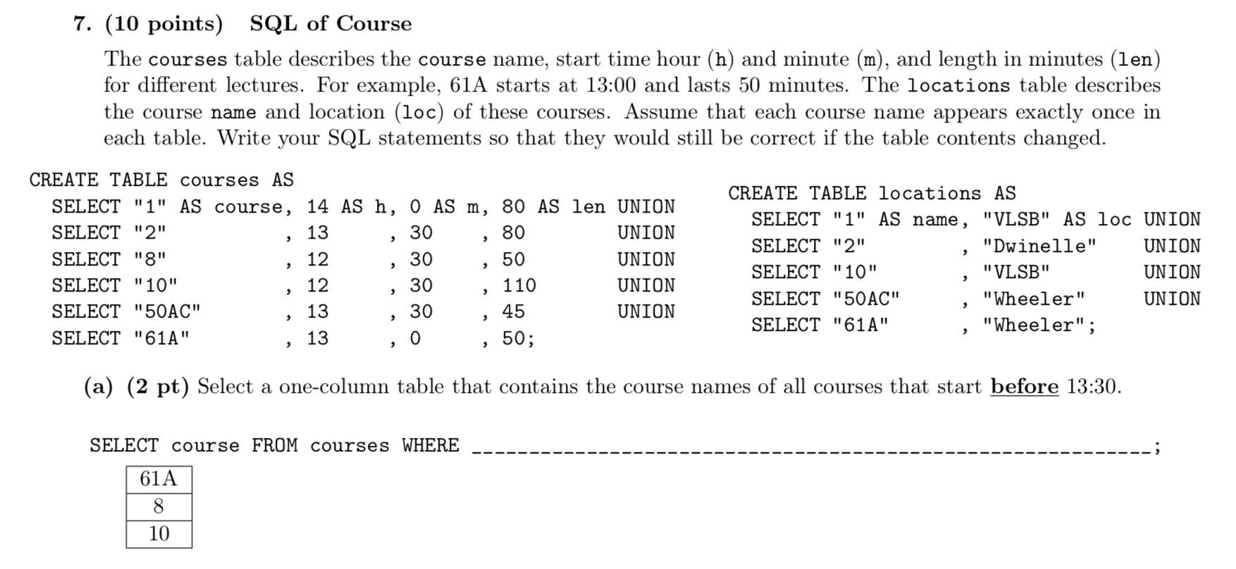
Fa18 Final Q7

Slide 179
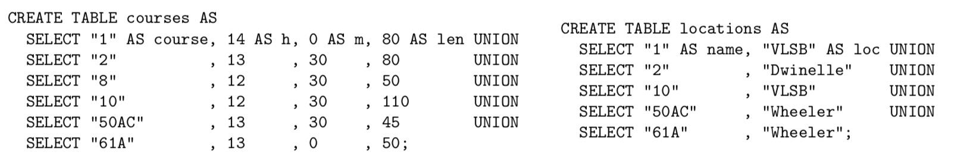
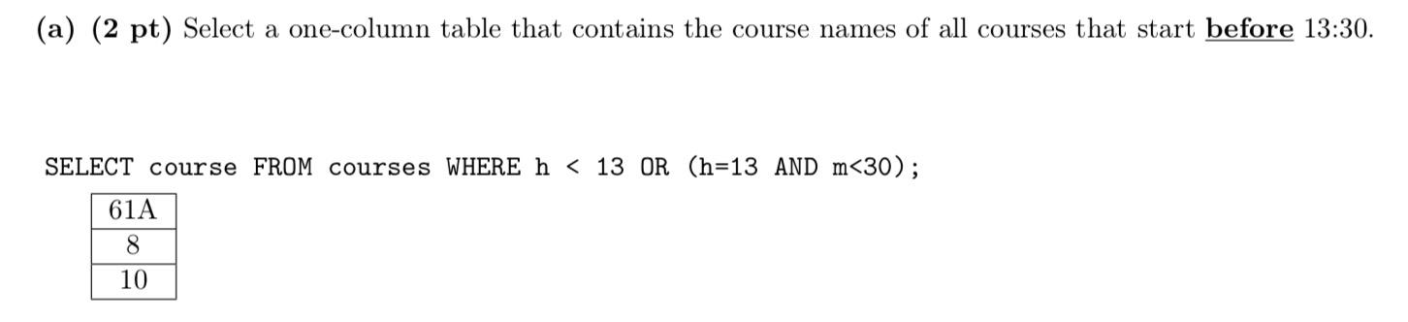
Fa18 Final Q7

Slide 180
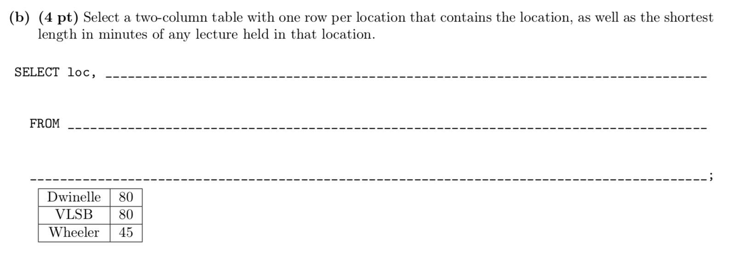
Fa18 Final Q7

Slide 181
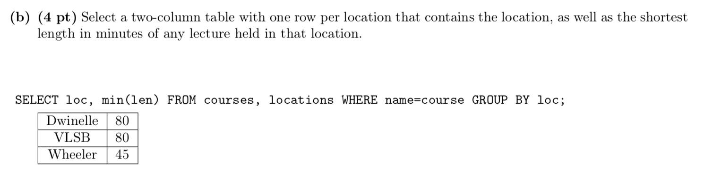
Fa18 Final Q7

Slide 182
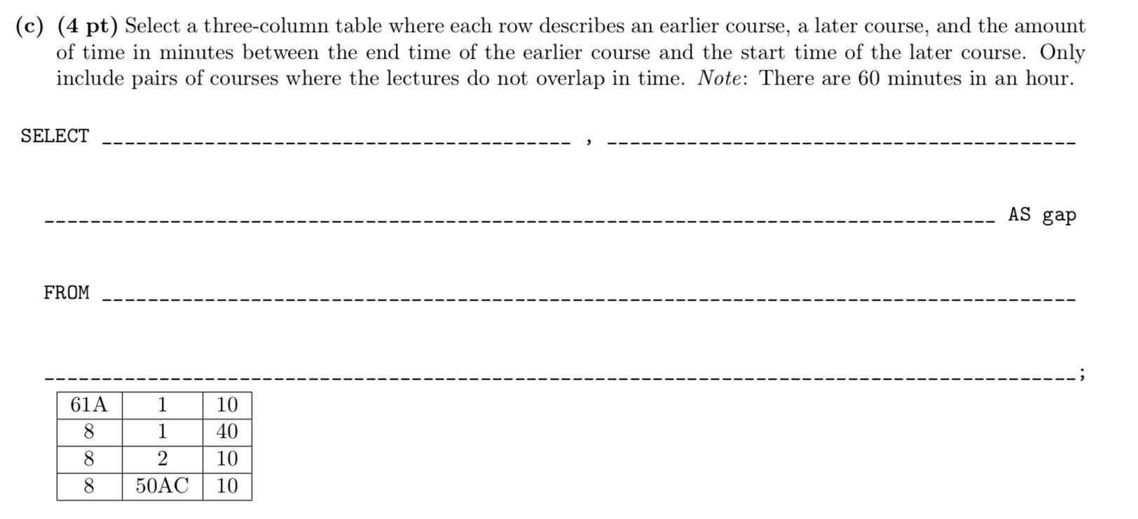
Fa18 Final Q7

Slide 183
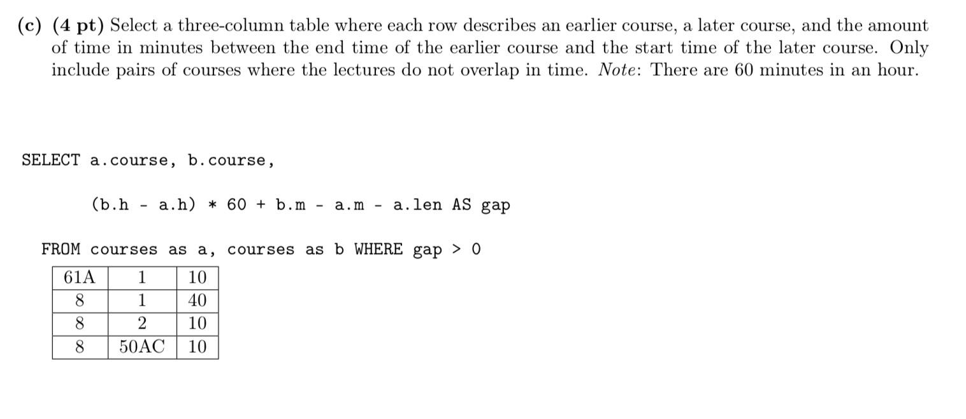
Fa18 Final Q7

Slide 184
Others
Iterators in Python
Streams in Scheme
Interpreters
Tail Recursion
…

Slide 185
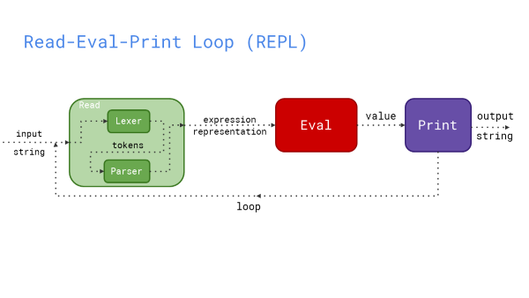
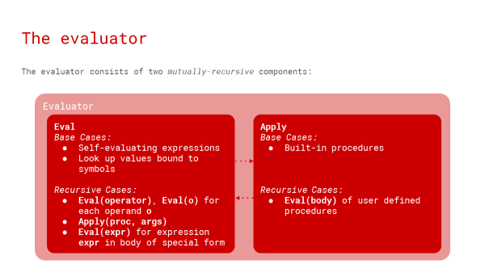
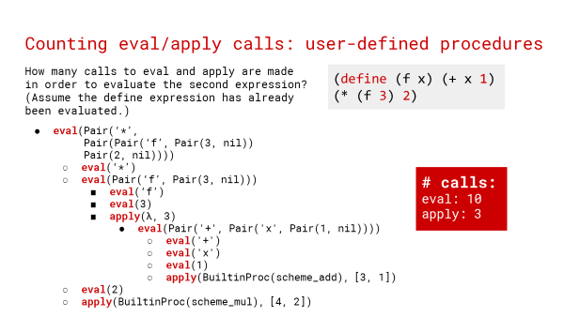

Slide 186
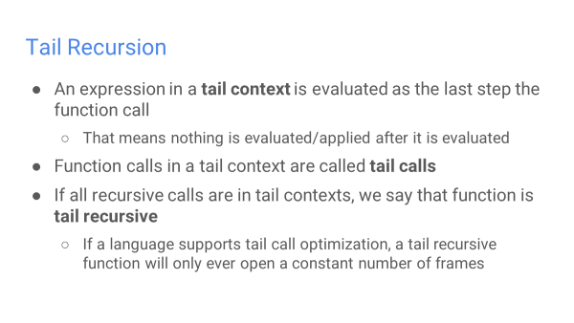
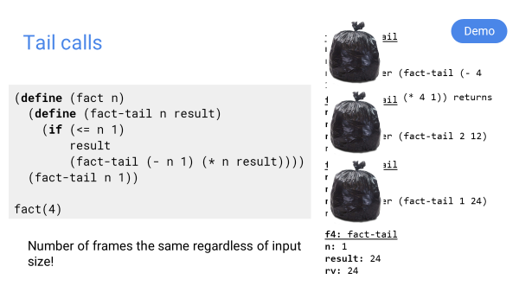

Slide 187
Parting Thoughts

Slide 188
Expand your perspective

Slide 189
Celebrate your accomplishments

Slide 190
Don’t compare

Slide 191
感谢各位助教！
范伟杰
宋建伟
匡育文
查君鹏

Slide 192
Q&A
Ask us anything!

